Slide 1
Venezuela’s Willfully Induced
Electrical Crisis

Slide 2
A willfully induced crisis
This summary presents a rendering of the Venezuelan Electrical Sector, covering events and data discoveries about why Venezuela continues to labor through a continued Electrical Crisis.
This is in spite of having “spent” enormous resources and unrecoverable time that has left the country with unceasing damages approaching astronomical figures in terms of loss of quality of life to her society, energy not served and GDP contractions, widespread scarcity and rampant inflation.
One other thing Venezuela did get is: the most expensive and most substandard performing Thermal Power Generation Fleet in the world, by any International Industry Standards imaginable.
This need not happen… Let us see the monetary side fueled by corruption, greed and lack of adequate basic controls… Through 46 power generation projects…

Slide 3
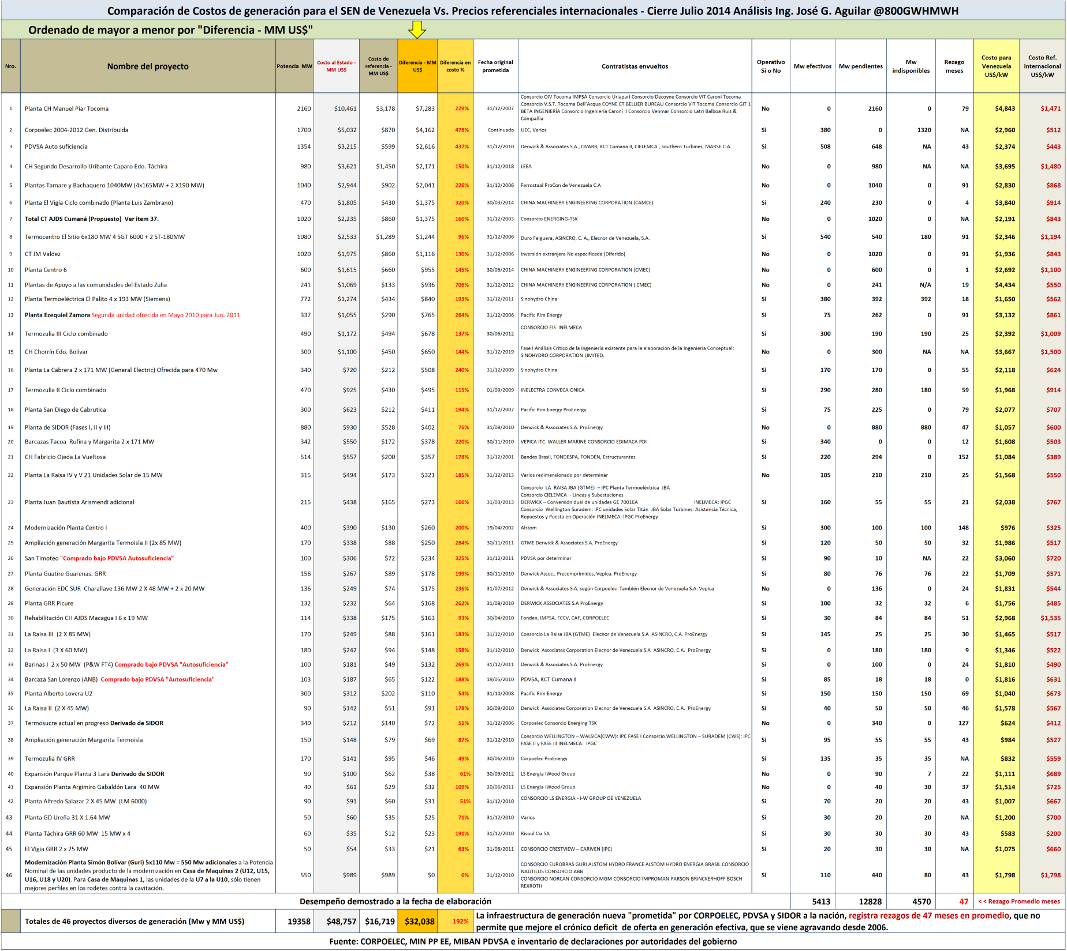

Slide 4
Let us look at the
thermal generation projects

Slide 5
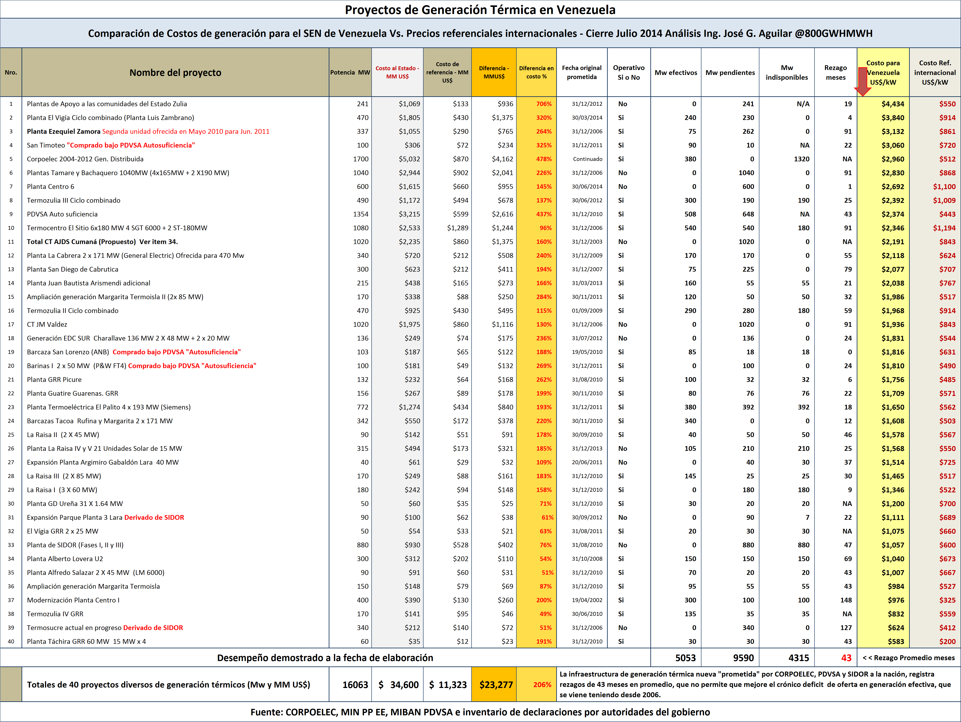

Slide 6
Let us look at the
hydroelectric generation projects

Slide 7
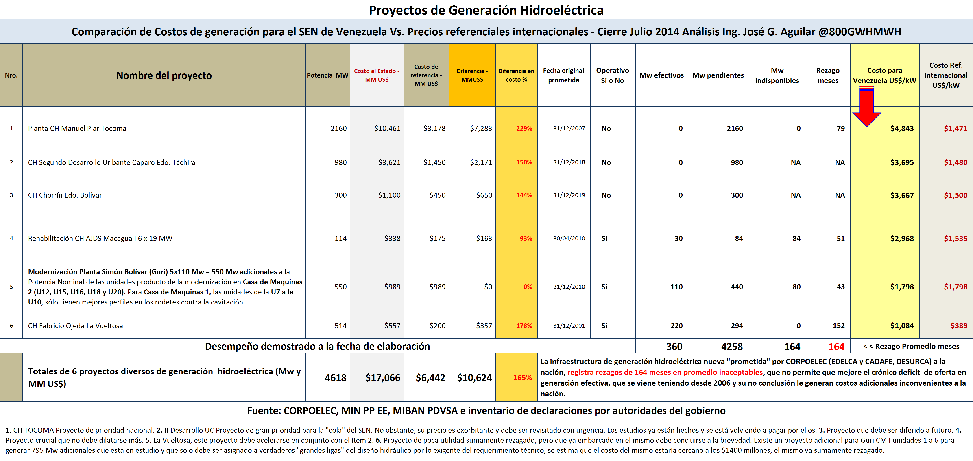

Slide 8
Let us take a closer look at the
thermal generation projects
First… Simple Cycle Plants

Slide 9
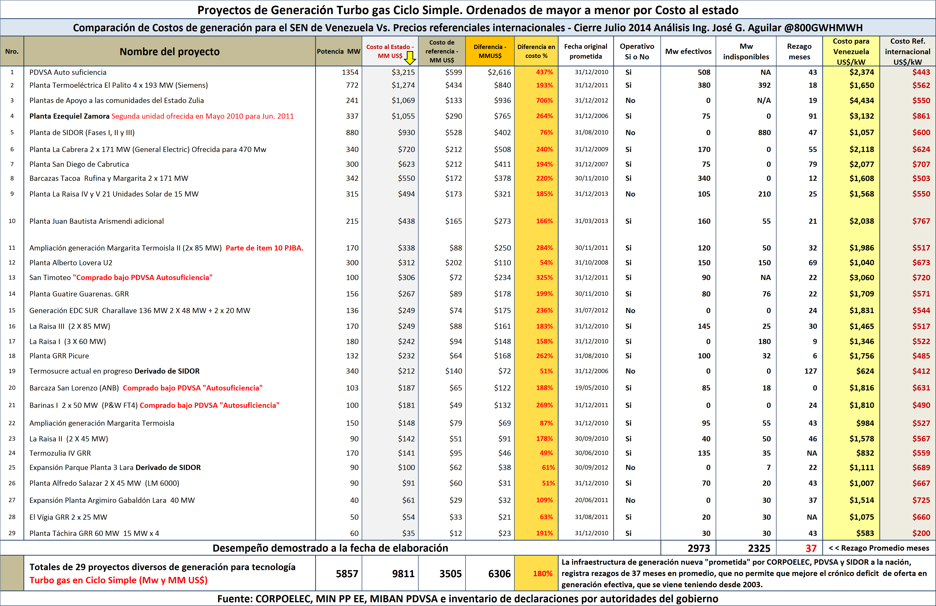

Slide 10
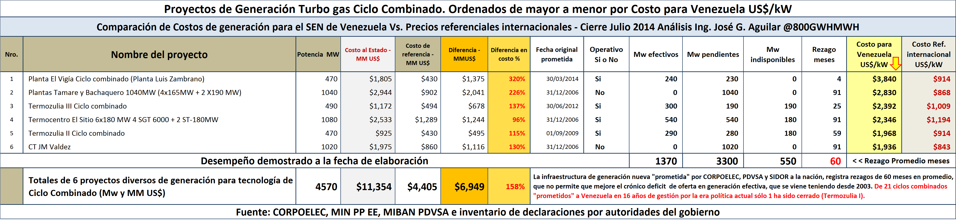
Combined Cycle Plants

Slide 11
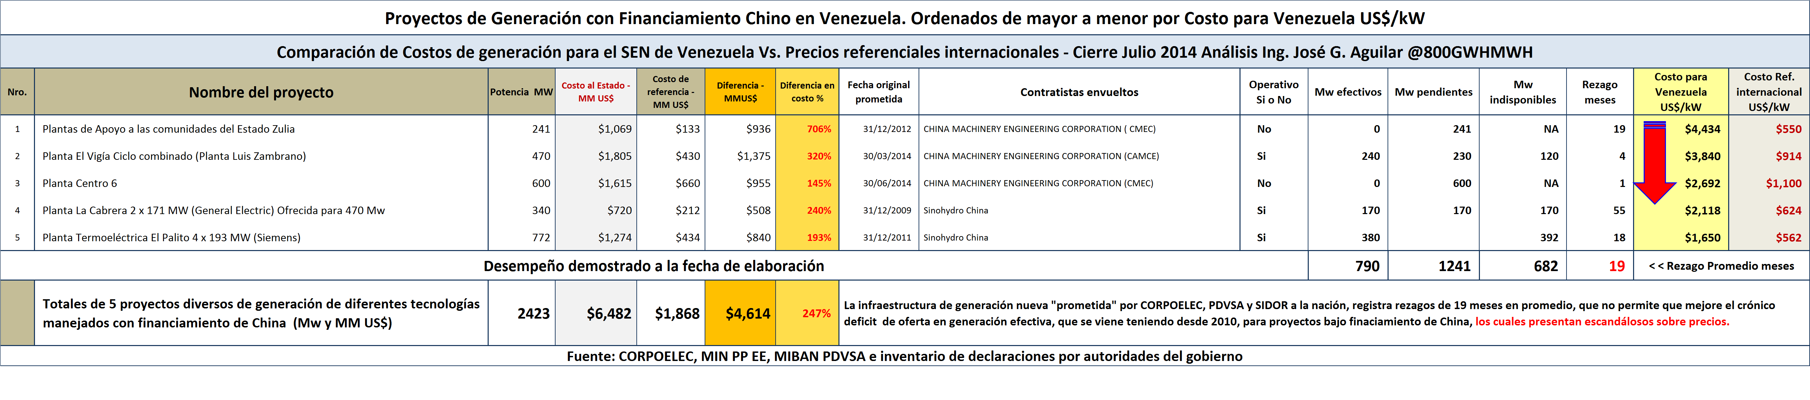
The New Corruption Dragon…

Slide 12
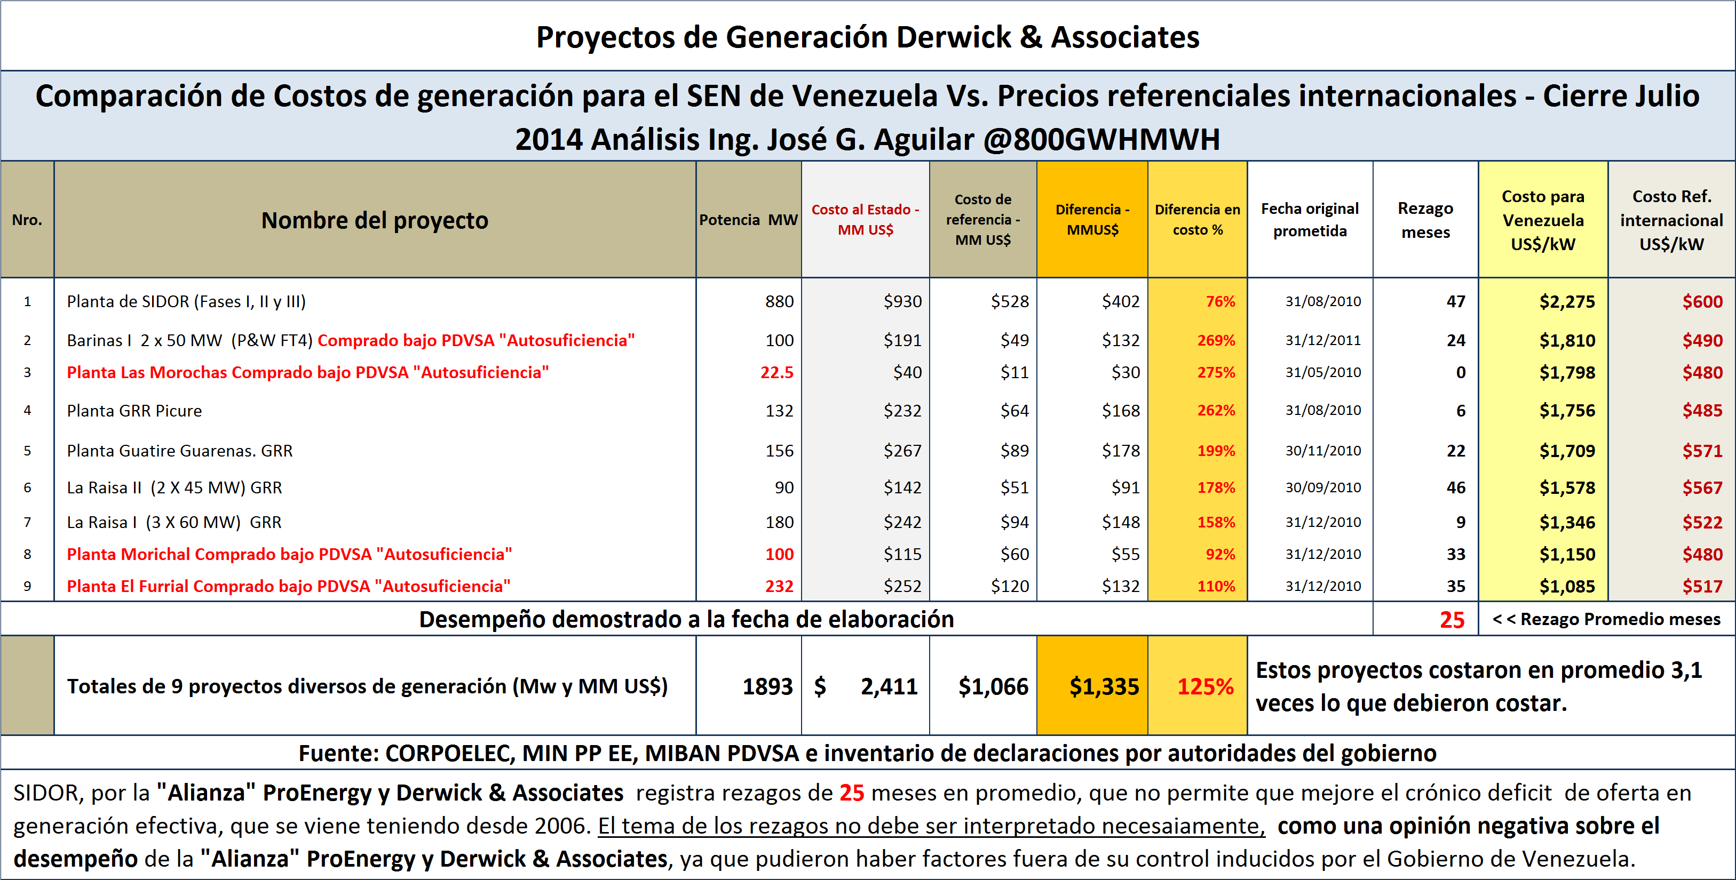

Slide 13
It is the year 2008 and the Caroní River continues to pour water into the Guri Reservoir in record numbers, the country at large is unsuspecting that a looming “Electrical Crisis” in the electrical sector is on the horizon. This is kept from the Public.
However, at the highest spheres of power within the Venezuelan Government a special project christened “Emergencia Eléctrica”, hereafter referred to as the Emergency, was underway a la “Insider Trading” in complicity with the influential and well-connected.

Slide 14
The Government equipped with the information from the predictive models of the Caroní´s
River Basin Hydrology, knew the probability of the upcoming cyclic reduction in influx of water
to the Guri Dam, both in intensity and duration.
To assure the Electrical Crisis, would be front and center the Government willfully over exploited
the Guri Dam during 2009 and launched an unprecedented Media Propaganda Blitz to affect the
psychic of the Venezuelan people. The country would have been better served had those resources been put to use in the acquisition of spare parts and much needed maintenance of the thermal fleet.
This “Insider knowledge” by the Government and their accomplices set out to defraud the Venezuelan People.

Slide 15
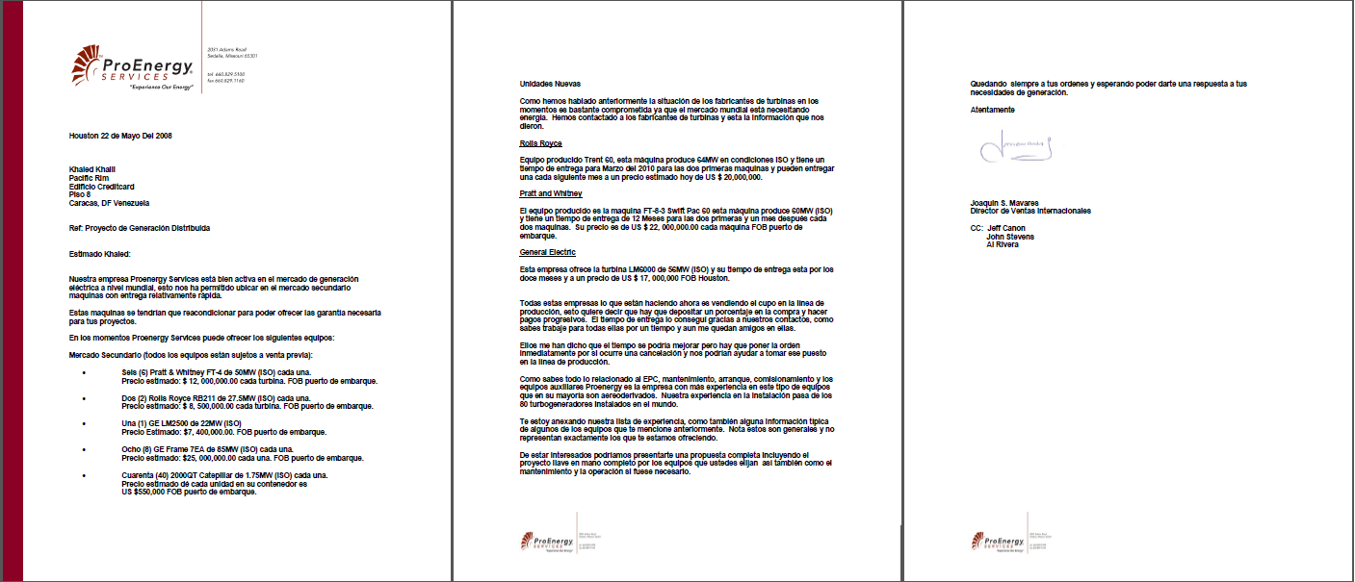

Slide 16
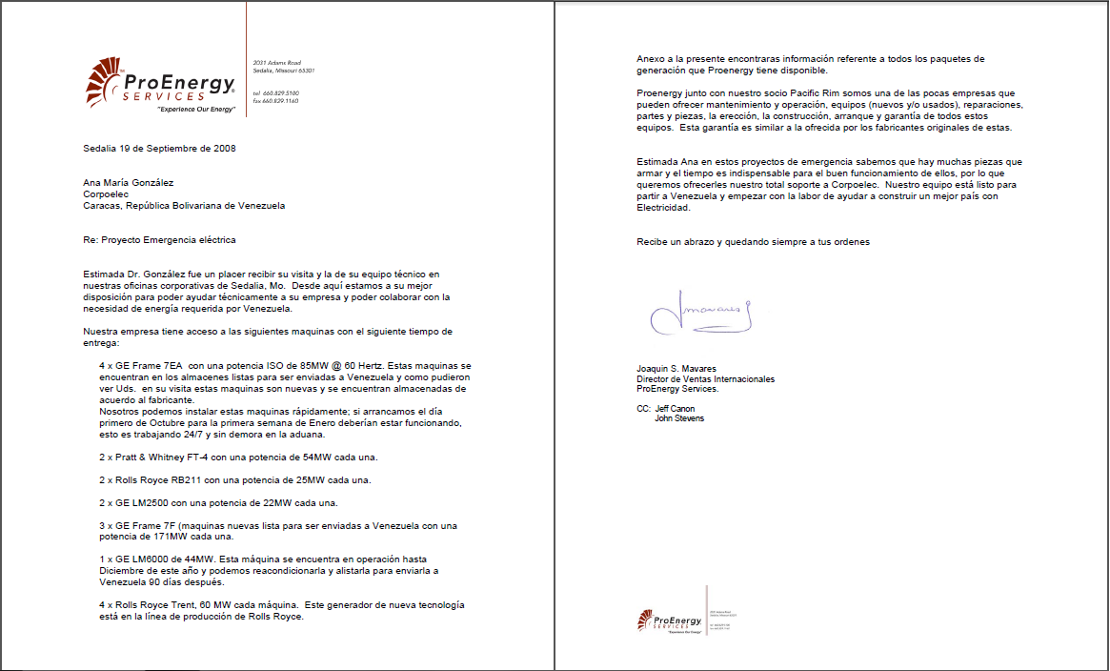

Slide 17
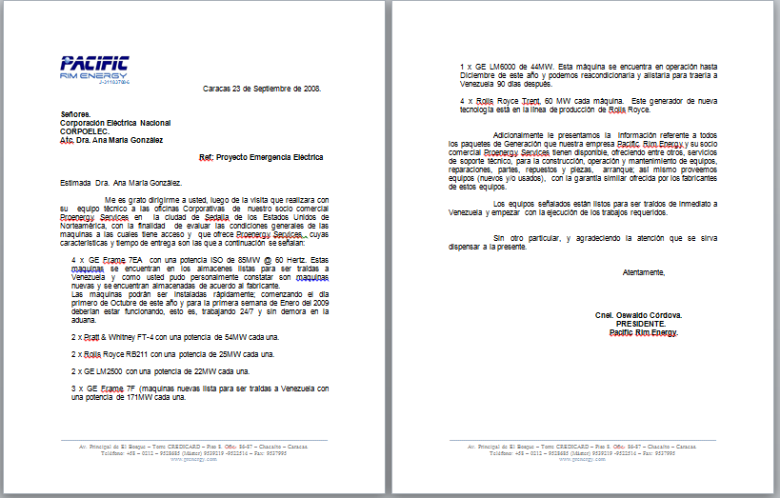

Slide 18
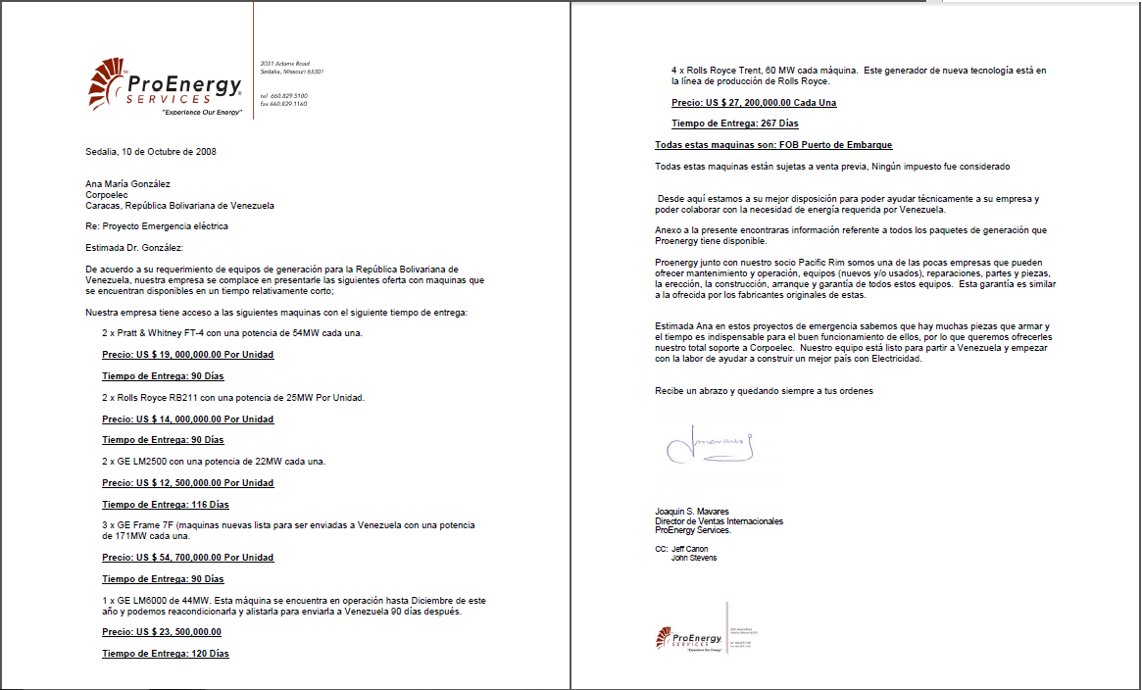

Slide 19
But all of this drama and waste for a 2% chance of reaching the critical water level at the Guri Dam of 240 masl.

Slide 20
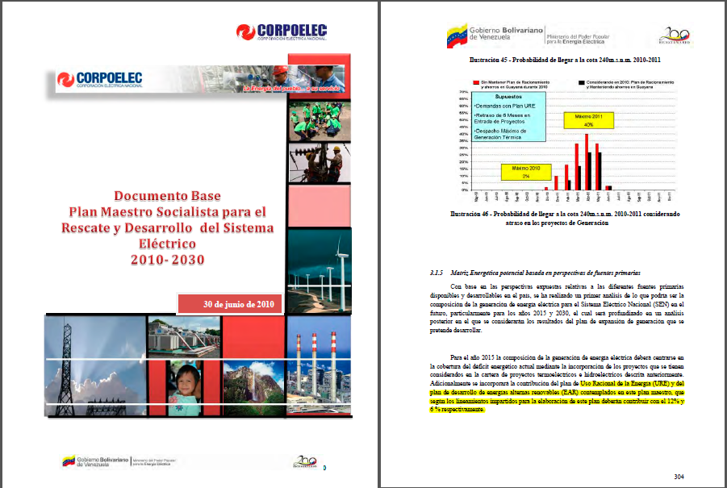

Slide 21
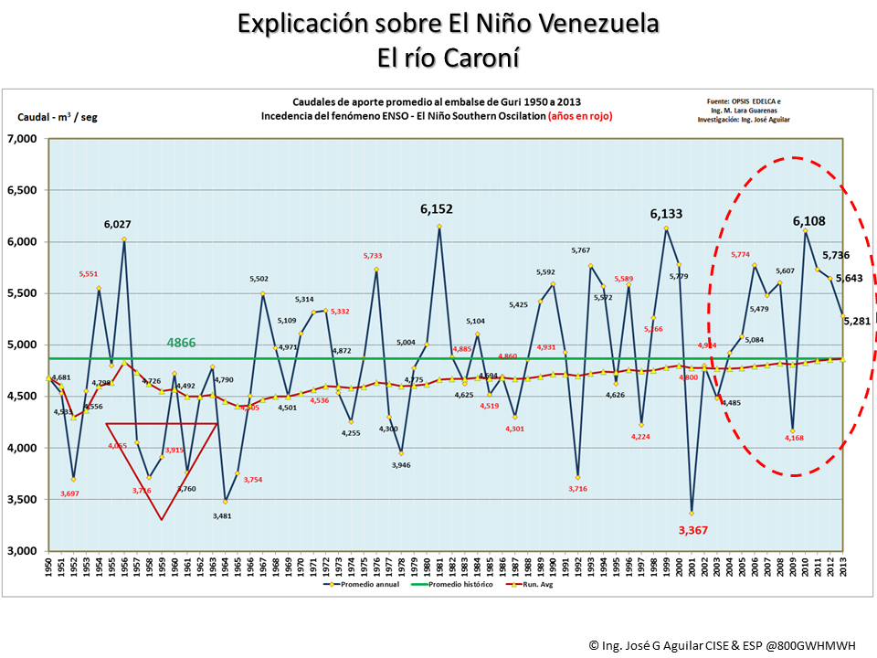

Slide 22
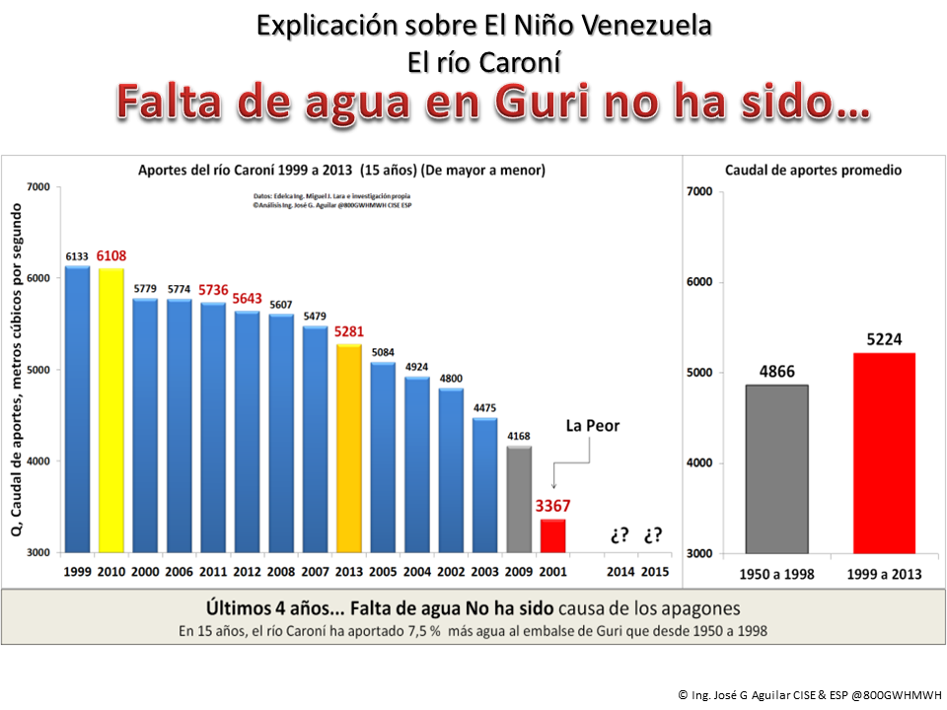

Slide 23
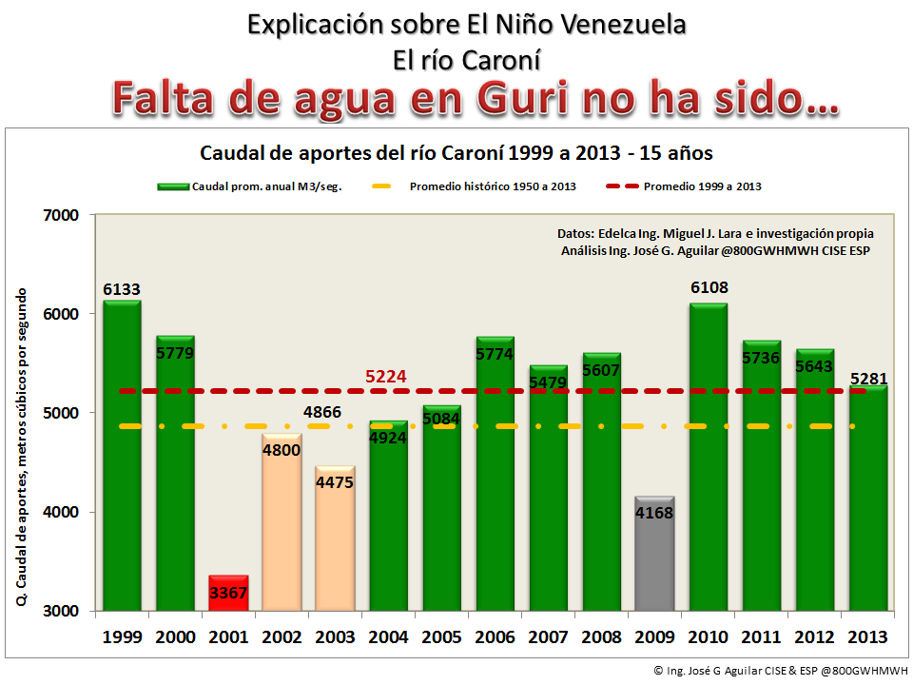

Slide 24
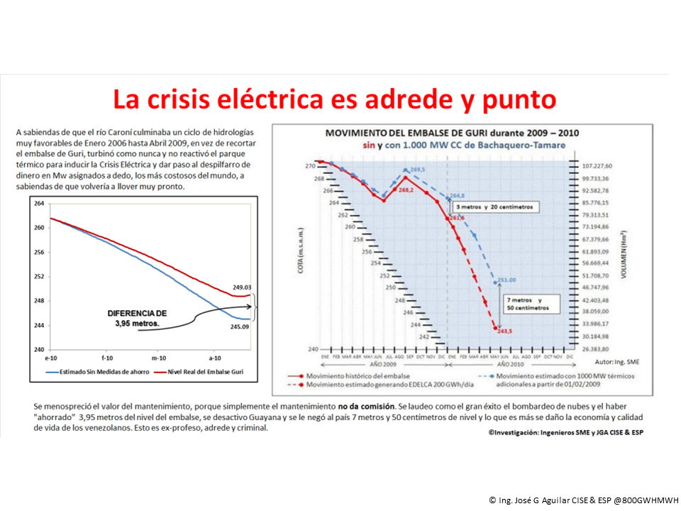

Slide 25
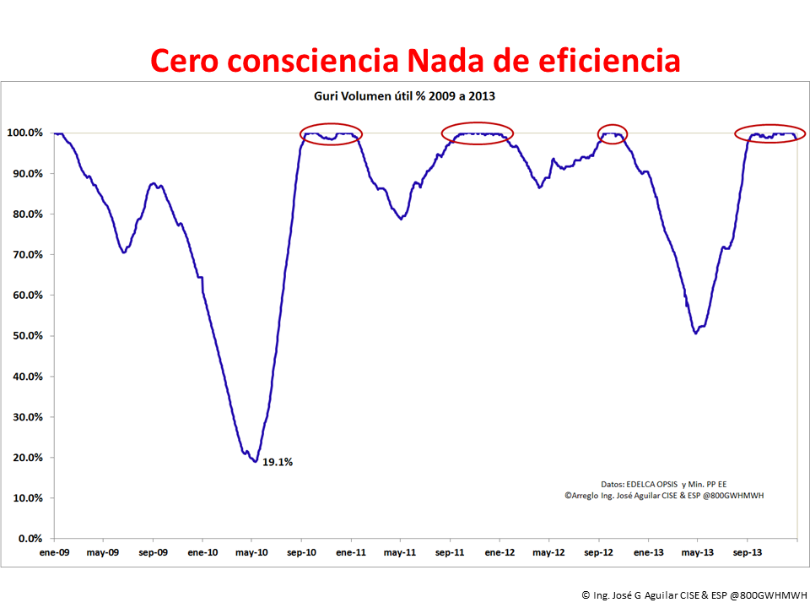

Slide 26
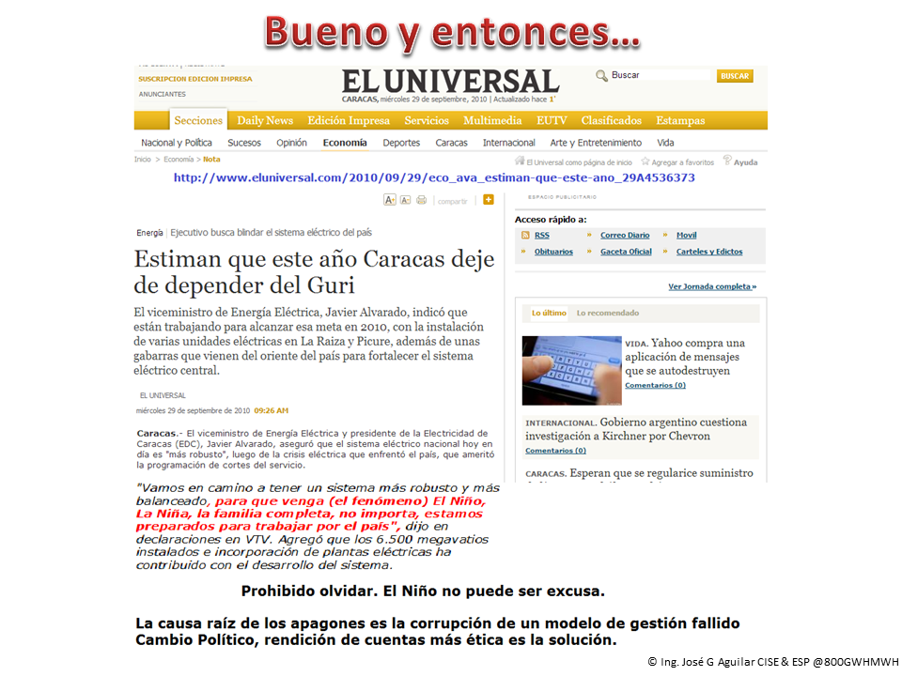

Slide 27
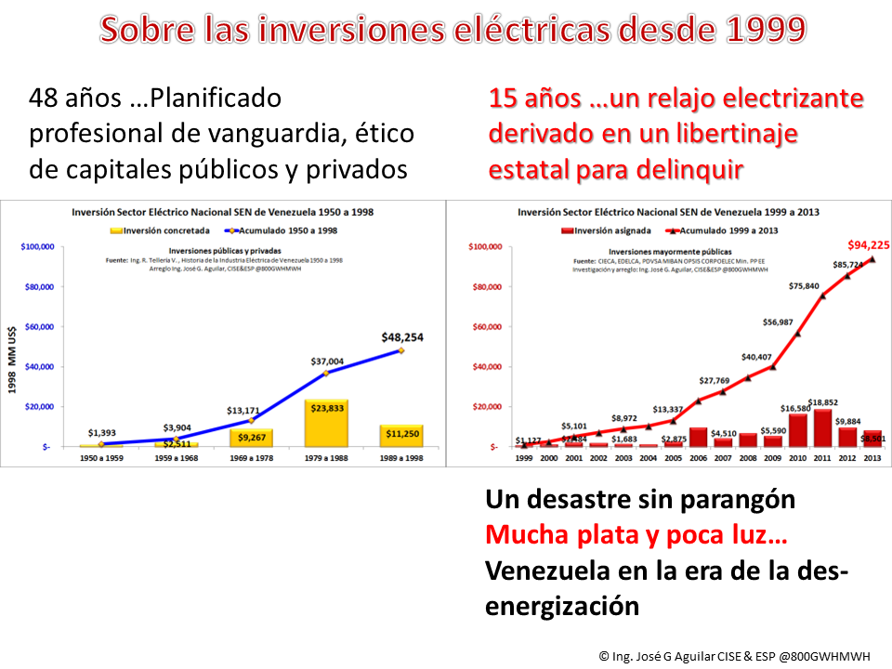

Slide 28
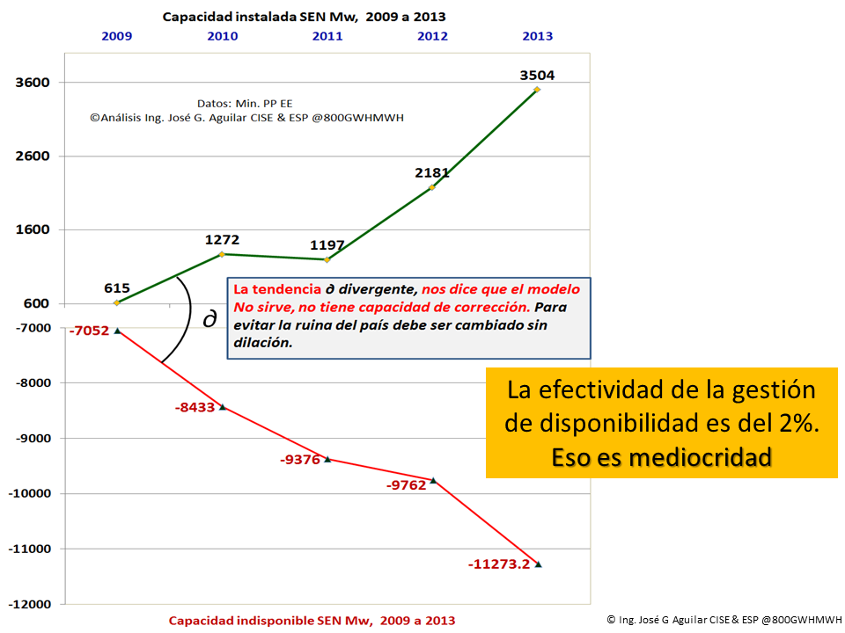

Slide 29
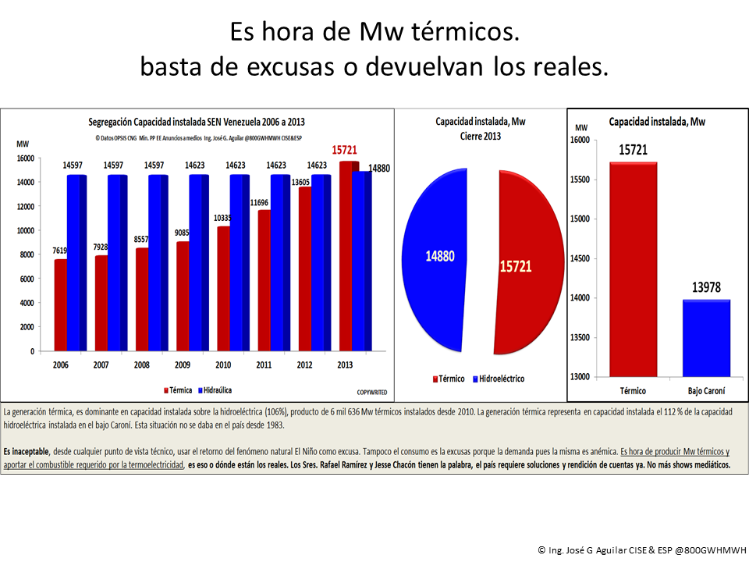

Slide 30
